Slide 1
CATEGORIES OF PERSONAL COMPUTER HARDWARE CONT.
BTO1052 Computer Hardware
Week 6-7
Dr. M. Fatih ERKOÇ

Slide 2
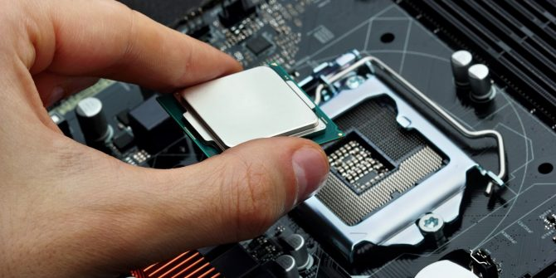
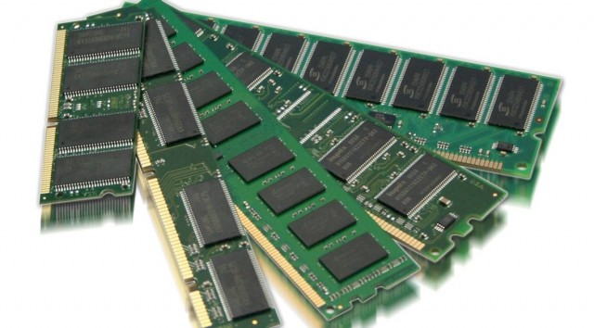
Six Categories of Hardware: 4. Processing
CPU: Hardware that interprets and executes software and coordinates all hardware.
RAM: Temporary holding area for information and software.

Slide 3
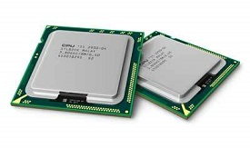
Central Processing Unit (CPU)
Alternately referred to as a processor, central processor, or microprocessor, the CPU is the central processing unit of the computer.
CPU consists of the following features;
CPU is considered as the brain of the computer.
CPU performs all types of data processing operations.
It controls the operation of all parts of the computer.

Slide 4
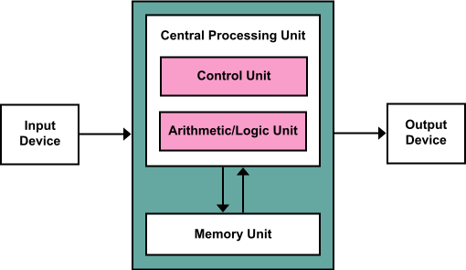
Central Processing Unit (CPU)…
CPU itself has following two main components.
Control Unit
ALU(Arithmetic Logic Unit)

Slide 5
Control Unit
Controls the operations of all parts of the computer; but does not carry out any actual data processing operations.
Functions of this unit are;
It is responsible for controlling the transfer of data and instructions among other units of a computer.
It manages and coordinates all the units of the computer.
It obtains the instructions from the memory, interprets them, and directs the operation of the computer.
It communicates with Input/Output devices for transfer of data or results from storage.
It does not process or store data.

Slide 6
ALU (Arithmetic Logic Unit)
This unit consists of two subsections namely;
Arithmetic Section:
Function of arithmetic section is to perform arithmetic operations like addition, subtraction, multiplication, and division.
Logic Section:
Function of logic section is to perform logic operations such as comparing, selecting, matching, and merging of data.

Slide 7
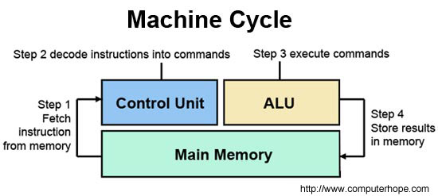
Speed of CPU
CPU speed measured in gigahertz (GHz)
The hertz (symbol: Hz) is the derived unit of frequency in the International System of Units (SI) and is defined as one cycle per second.
1 GHz = 1.000.000 cycle per second. (1000MHz)
CPU (machine) cycle – retrieve, decode, and execute instruction, then return result to RAM if necessary.

Slide 8
CPU History
Baron Jons Jackob Berzelius discovers silicon (Si), which today is the basic component of processors in1823.
John Bardeen, Walter Brattain, and William Shockley invent the first transistor at the Bell Laboratories on December 23, 1947.
The first integrated circuit was first developed by Robert Noyce of Fairchild Semiconductor and Jack Kilby of Texas Instruments. The first IC was demonstrated on September 12, 1958.
Intel Corporation was founded by Robert Noyce and Gordon Moore in 1968.
AMD (Advanced Micro Devices) was founded on May 1, 1969.
Notes:
Intel released the Pentium processor on March 22, 1993. The processor was a 60 MHz processor, incorporates 3.1 million transistors and sells for $878.00.

Slide 9
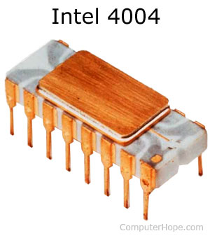
CPU History…
The CPU was first developed at Intel with the help of Ted Hoff and others in the early 1970's.
The first processor released by Intel was the 4004 processor.
The 4004
had 2,300 transistors,
performed 60,000 OPS (operations per second),
addressed 640 bytes of memory,
and cost $200.00.

Slide 10
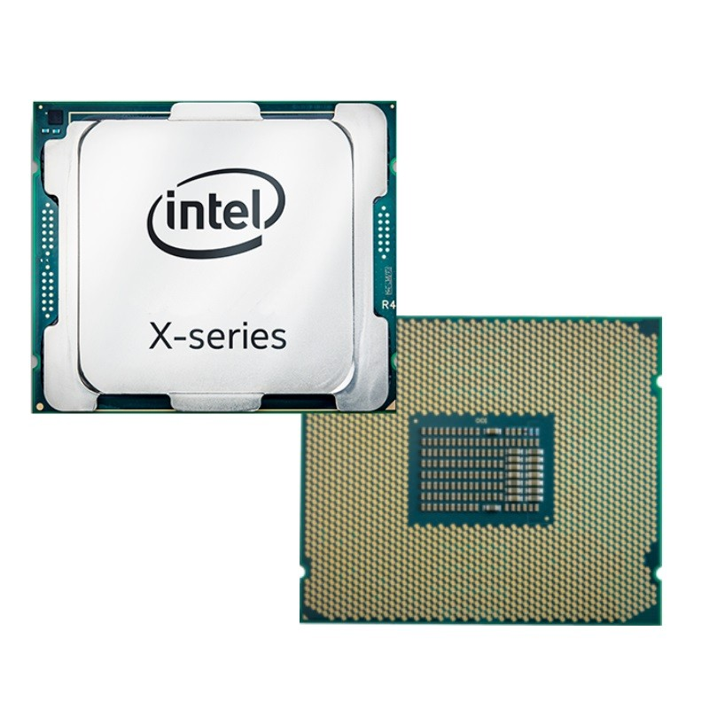
CPU History…
Intel released the first desktop processor with 18 cores, the Core i9-7980X, in September 2017.
It runs at 2.6 GHZ
24.75 MB L3 cache.
We can estimate that it has 7 billion transistors,
based on model number (79xx).

Slide 11
AMD Processors
K6-2 K6-III Athlon Duron Athlon XP | Sempron Athlon 64 Mobile Athlon 64 Athlon XP-M Athlon 64 FX | Turion 64 Athlon 64 X2 Turion 64 X2 Phenom FX Phenom X4 | Phenom X3 Athlon 6-series Athlon 4-series Athlon X2 Phenom II | Athlon II E2 series A4 series A6 series A8 series A10 series

Slide 12
Intel Processors
4004 8080 8086 8087 8088 80286 (286) 80386 (386) 80486 (486) | Pentium Pentium w/ MMX Pentium Pro Pentium II Celeron Pentium III Pentium M Celeron M | Pentium 4 Mobile Pentium 4-M Pentium D | Pentium Extreme Edition Core Duo Core 2 Duo | Core i3 Core i5 Core i7 Core i9

Slide 13
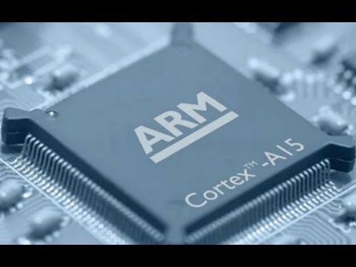
ARM CPU
Some mobile devices, like smartphones and tablets, use ARM CPUs.
These CPUs are smaller in size, require less power, and generate less heat.
The ARM processor is a 32-bit RISC
processor, meaning it is built using the
RISC (reduced instruction set computer).
They are also used in PDAs (personal digital
assistants), digital media and music
players, hand-held gaming systems, calculators,
and even computer hard drives.

Slide 14

What's Inside a CPU

Slide 15
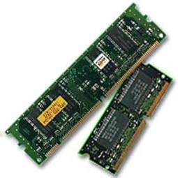
Random Access Memory (RAM)
RAM is the internal memory of the CPU for storing data, program, and program result.
It is a read/write memory which stores data until the machine is working.
RAM is volatile, i.e. data stored in it is lost when we switch off the computer or if there is a power failure.
RAM is small, both in terms of its physical size
and in the amount of data it can hold.
RAM is of two types;
Static RAM (SRAM)
Dynamic RAM (DRAM)

Slide 16
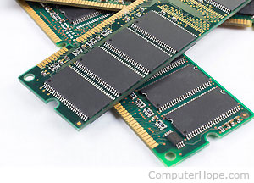
Types of RAM: SRAM
The word static indicates that the memory retains its contents as long as power is being supplied.
RAM chips use a matrix of 6-transistors and no capacitors.
Power consumption varies widely based on how frequently the memory is accessed.
SRAM is more expensive and holds less data
per unit volume.
It is more commonly used in cache and
video card memory only.

Slide 17
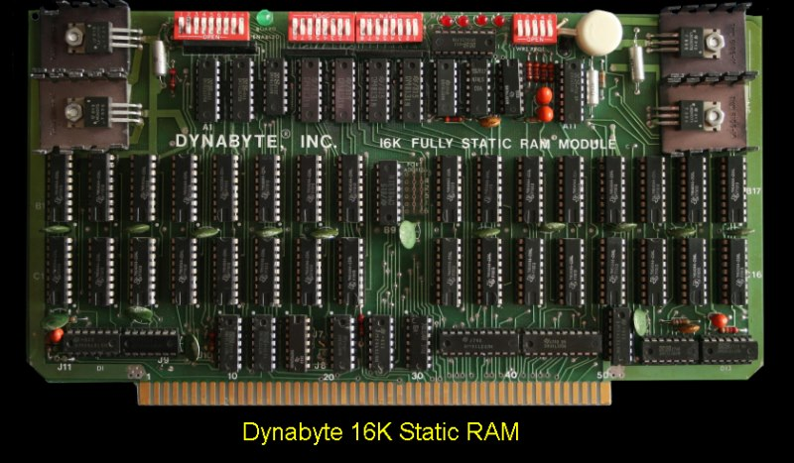
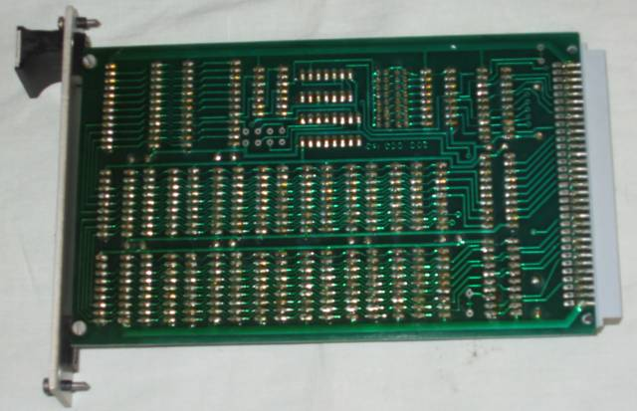
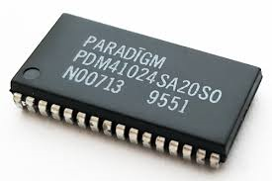
Characteristic of Static RAM
Long life
No need to refresh
Faster
Used as cache memory (CPU Memory)
Large size
Expensive
High power consumption

Slide 18
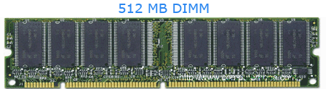
Types of RAM: DRAM (Dynamic)
It is the most commonly found RAM modules in PC compatible personal computers and workstations.
It stores its information in a cell containing a capacitor and transistor.
These cells must be refreshed with new electricity every few milliseconds for the memory to keep holding its data.

Slide 19
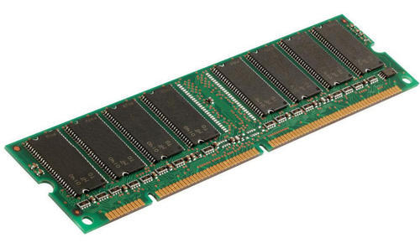
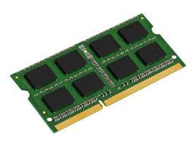
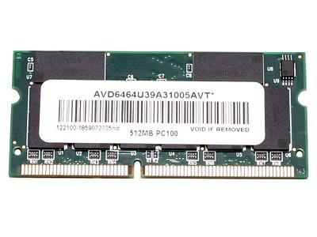
Characteristics of Dynamic RAM
Short data lifetime
Needs to be refreshed continuously
Slower as compared to SRAM
Used as RAM
Smaller in size
Less expensive
Less power consumption

Slide 20

What is Random Access Memory?

Slide 21
Synchronous DRAM (SD-RAM)
Memory chips are organized into “modules” that are connected to the CPU via a 64-bit (8-byte) bus.
Speeds are rated in megahertz: PC66, PC100 and PC133 memory run at 66MHz, 100MHz and 133MHz respectively.
Memory bandwidth (transfer package/sec)= Frequency x size of each transfer
PC100 can transfer up to 800MB/sec ➔(100MHz x 8 bytes/cycle).
Example: We have a 2133Mhz DDR4 RAM. What is the memory bandwith?
Mem Band. = 2133Mhz x 8bytes/cycle.
=~17.000 MB/sec

Slide 22
Double Data Rate RAM (DDR-RAM)
Similar to regular SDRAM, except data can be transferred on both the positive and negative clock edges.
For 100-133MHz buses, the effective memory speeds appear to be 200-266MHz.
DDR-RAM has lower power consumption, using 2.5V instead of 3.3V like SDRAM. This makes it good for notebooks and other mobile devices.

Slide 23
Example
Given a DDR-RAM with bus speed of 133MHz and bus width of 8-bytes (64-bit).
Find the:
A- Effective memory speed?
Since data can be transferred on positive and negative edge then
Effective memory speed = 2 X 133MH
B- Maximum transfer rate?
= 266MHz X 8 bytes/cycle
= 2128 MB/sec

Slide 24
Rambus Double Data Rate RAM (RDRAM)
Another new type of memory called RDRAM is used in the Playstation 2 as well as some Pentium 4 computers.
The data bus is only 16 bits wide.
But the memory runs at 400MHz - 800Mhz, and data can be transferred on both the positive and negative clock edges.
That works out to a maximum transfer rate of 1.6GB per second for 400Mhz RAM.
You can also implement two “channels” of memory, resulting in up to 3.2GB/s of bandwidth.

Slide 25
Types of RAM According to Connection Modules
The more common examples are;
SIMM: Single In-line Memory Module
DIMM: Dual In-line Memory Module
RIMM: Rambus incorporated DRAM or RDRAM
SO-DIMM: Small Outline Dual In-line Memory Module
SO-RIMM: Small Outline Rambus incorporated DRAM or RDRAM

Slide 26
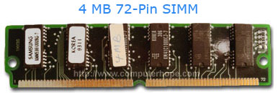
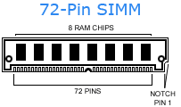
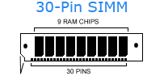
SIMM: Single In-line Memory Module
The SIMM circuit board that holds six to nine memory chips per board.
The SIMM was used with computers using a 486, early Intel Pentium, and compatible processors.

Slide 27
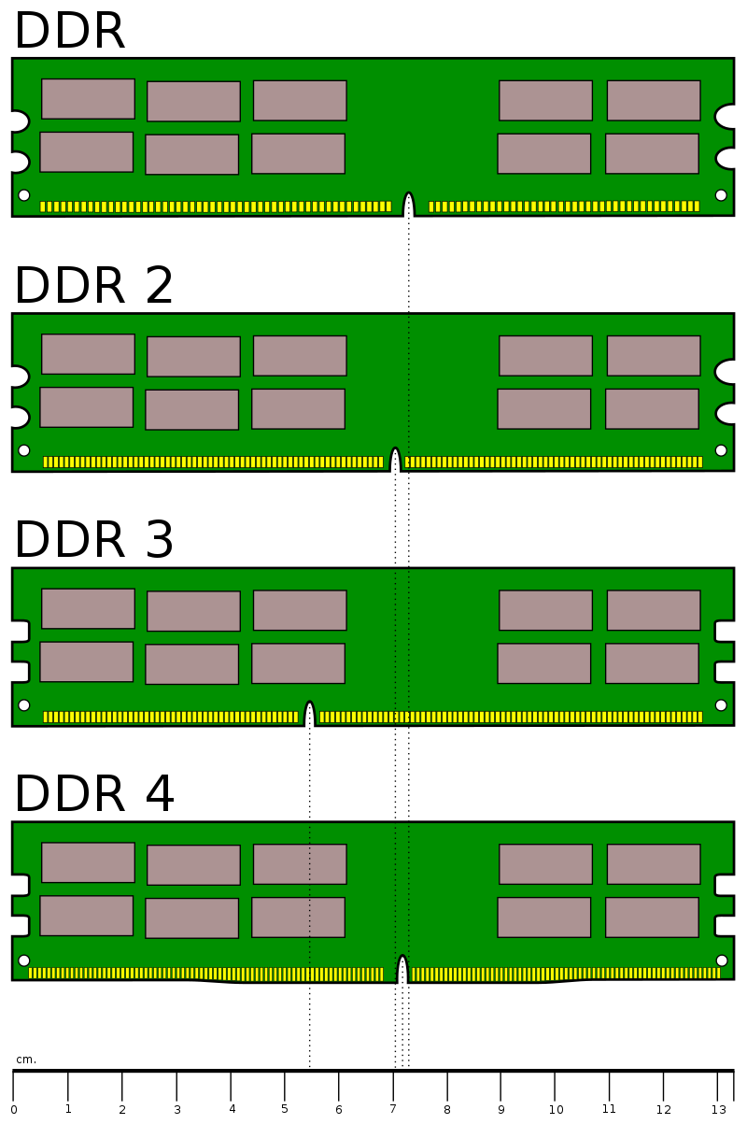
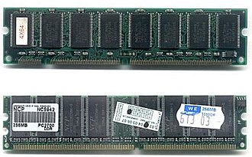
DIMM: Dual In-line Memory Module
DIMMs have a 168-pin connector and, from the advent of the Pentium processor, a 64-bit path.
32-bit path ➔ 2³² = 4,294,967,296 values
64-bit path ➔ 2⁶⁴ = 18,446,744,073,709,551,616 values.

Slide 28
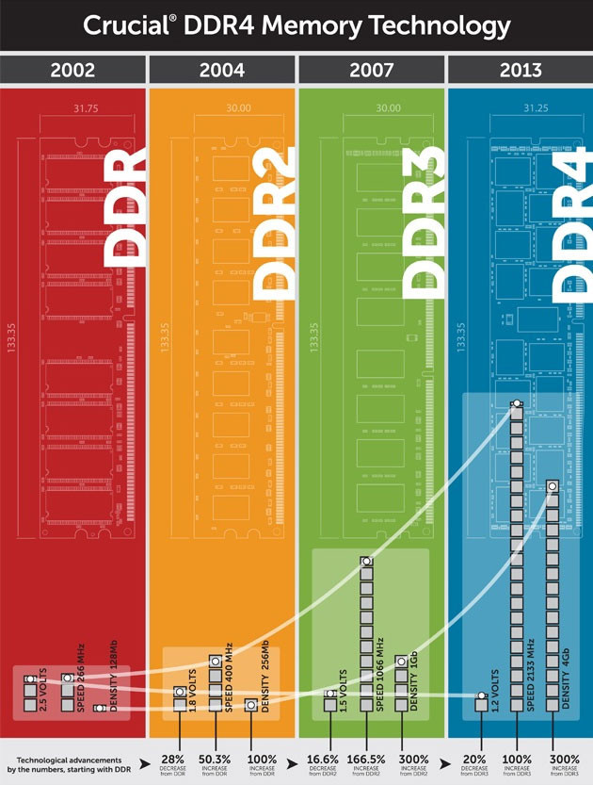
Evolution of DDR Ram
The most common DIMM types
1. 72-pin SO-DIMM
2. 100-pin DIMM, used for printer SDRAM
3. 144-pin SO-DIMM, used for SDR SDRAM
4. 168-pin DIMM, used for SDR SDRAM
5. 172-pin MicroDIMM, used for DDR SDRAM
6. 184-pin DIMM, used for DDR SDRAM
7. 200-pin SO-DIMM, used for DDR SDRAM and DDR2 SDRAM
8. 204-pin SO-DIMM, used for DDR3 SDRAM
9. 214-pin MicroDIMM, used for DDR2 SDRAM
10. 240-pin DIMM, used for DDR2 SDRAM, DDR3 SDRAM and FB-DIMM DRAM
11. 244-pin MiniDIMM, used for DDR2 SDRAM
12. 284-pin DIMM, used for DDR4 SDRAM

